Slide 1
Chapter: 8.2
Kinetic theory of gases

Slide 2
Ideal gas: A gas that perfectly obeys all the proposals of the kinetic theory of gases and the gas laws.
The kinetic theory of gases explains much of the physical behaviour of gases. The term ‘ kinetic’ comes from the Greek kinetikos, which means ‘moving’ , so many of the properties of gases are related to their motion.
The kinetic theory of gases proposes that:
1.Gases consist of molecules ( except noble gases which consist of atoms) that move in continual random straight –line motion.

Slide 3
2. The average distance between gas molecules is very large compared to the size of the molecule.
3. Intermolecular forces between molecules are negligible.
4. All collisions of gas molecules are perfectly elastic collisions, which means there is no net energy loss during these collisions.

Slide 4
5. Pressure is due to collisions of molecules with the walls of the container.
6. Temperature is a measure of the average kinetic energy of the molecules.
The kinetic theory of gases is used to explain the physical behaviour of gases.
This theory uses the model of an ideal gas.

Slide 5
Considering temperature
The kinetic theory states that temperature is a measure of average kinetic energy.
The molecules of a sample of gas have the same average kinetic energy, the individual molecules move at various speeds. Some move faster and some move slower than the average. Collisions between particles change individual speeds.

Slide 6
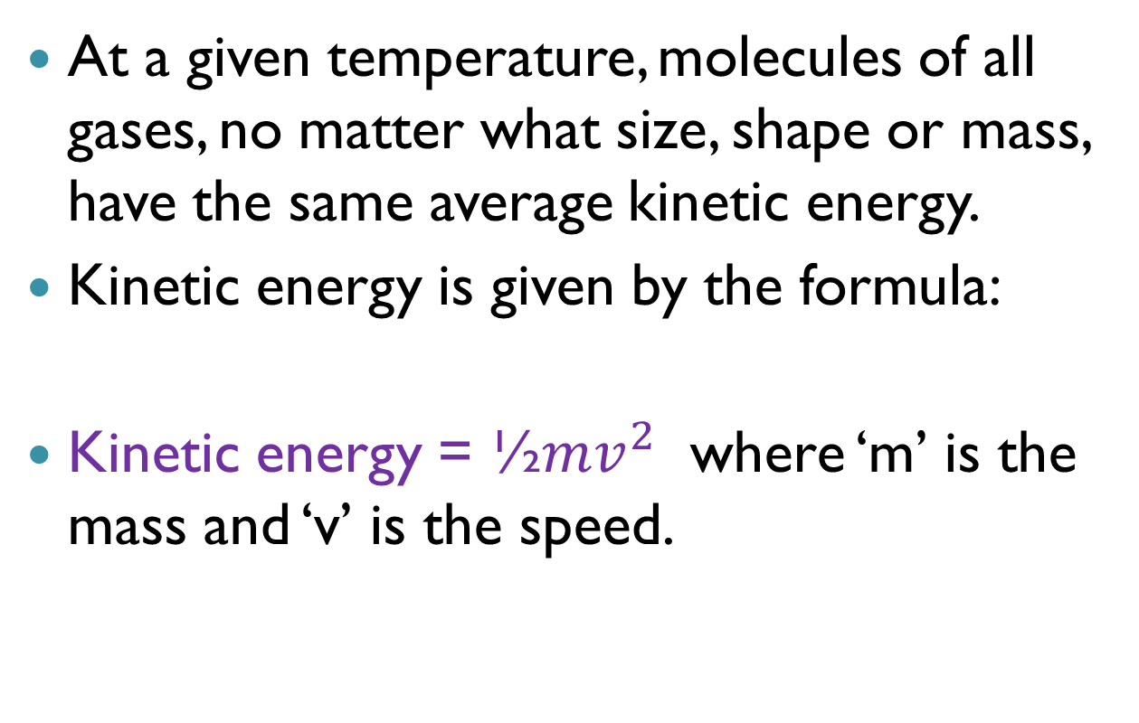
At a given temperature, molecules of all gases, no matter what size, shape or mass, have the same average kinetic energy.
Kinetic energy is given by the formula:
Kinetic energy = ½$mv^{2}$ where ‘m’ is the mass and ‘v’ is the speed.

Slide 7
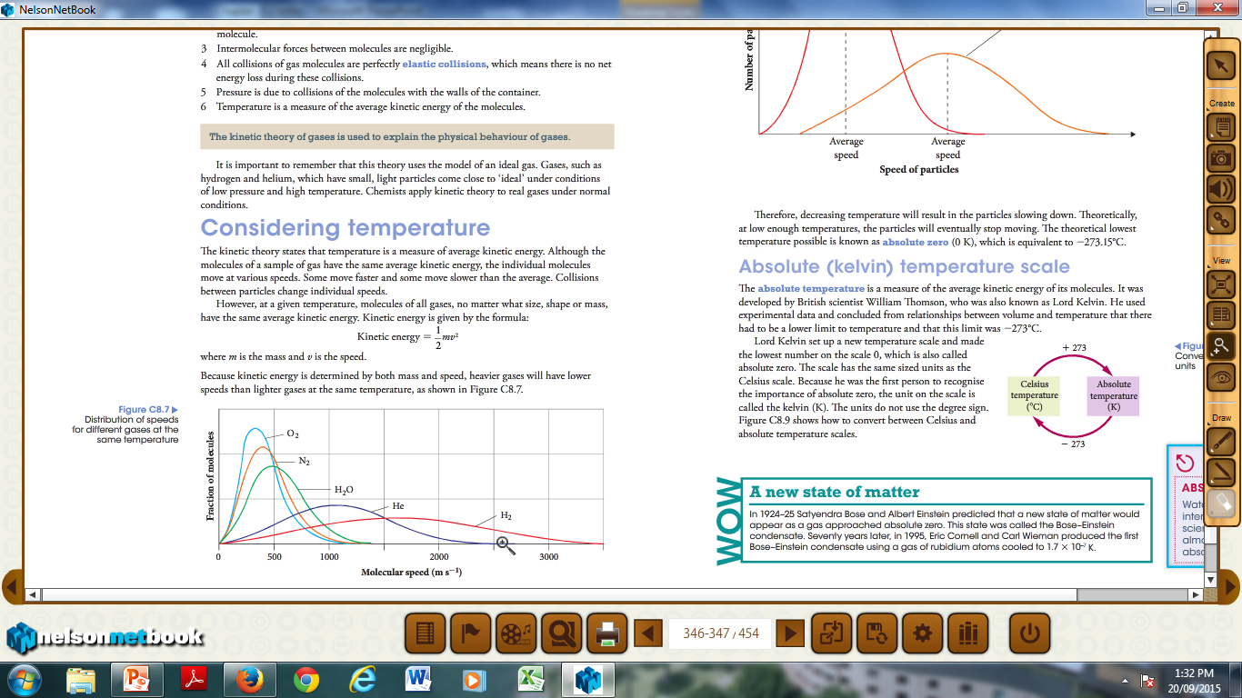
Kinetic energy is determined by both mass and speed, heavier gases will have lower speeds than lighter gases at the same temperature.

Slide 8
As the temperature increases, the KE of the particles increases and vice versa.
Although the gas particles have a range of speeds at any given temperature, the average speed of the particles of a gas increases as temperature increases.

Slide 9
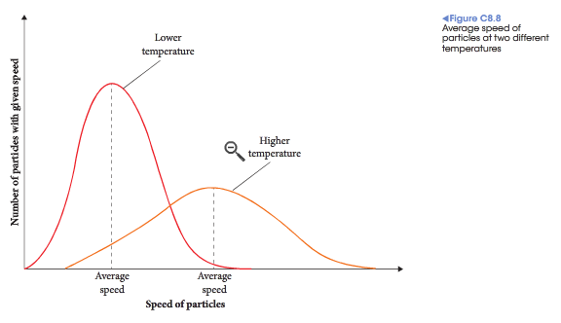

Slide 10
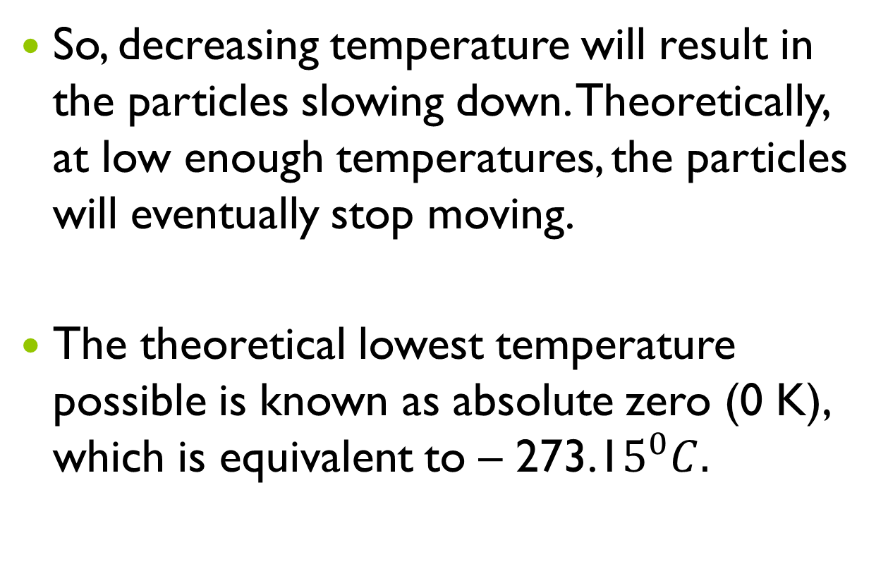
So, decreasing temperature will result in the particles slowing down. Theoretically, at low enough temperatures, the particles will eventually stop moving.
The theoretical lowest temperature possible is known as absolute zero (0 K), which is equivalent to – 273.1$5^{0}C.$

Slide 11
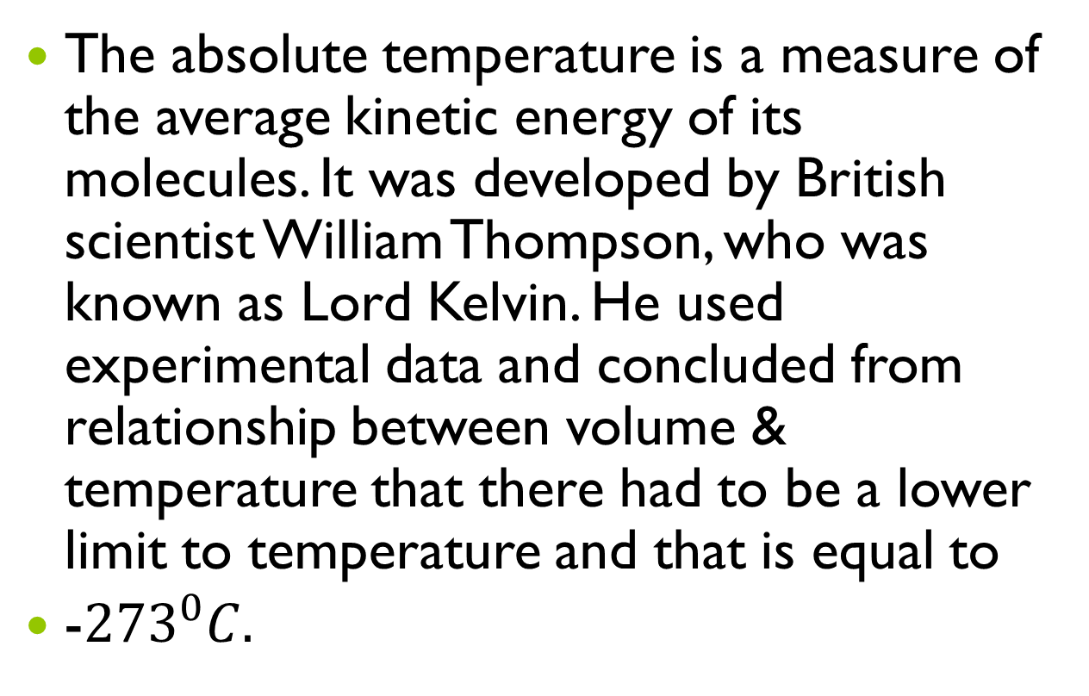
Absolute ( Kelvin) temperature scale
The absolute temperature is a measure of the average kinetic energy of its molecules. It was developed by British scientist William Thompson, who was known as Lord Kelvin. He used experimental data and concluded from relationship between volume & temperature that there had to be a lower limit to temperature and that is equal to
-${273}^{0}C.$

Slide 12
Lord Kelvin set up a new temperature scale and made lowest number on the scale 0, called as absolute zero. As the first person to recognise the importance of absolute zero, the unit on the scale is called as kelvin (K).

Slide 13
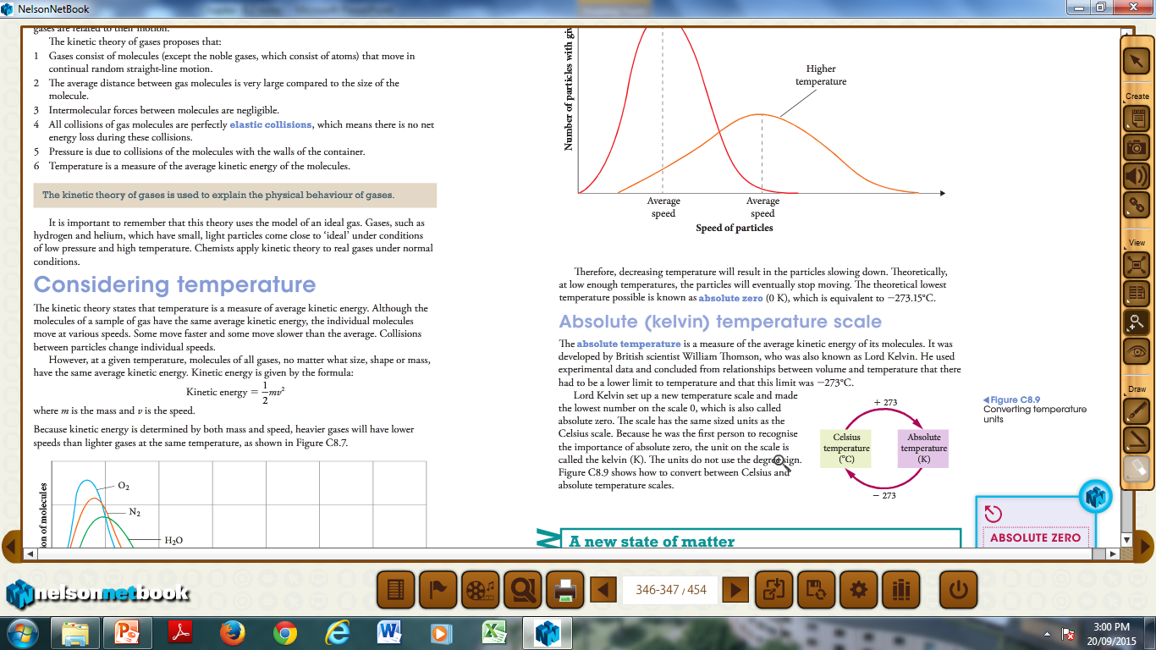

Slide 14
Applying the kinetic theory
The kinetic molecular theory was developed using the findings of many different scientists.
Gases diffuse, or spread, because gas particles have rapid, random motion and a lot of empty space between them so they quickly spread and mix.
Gases can be easily compressed because there is a lot of empty space between particles.

Slide 15
Gases spread to fill a container because there are negligible forces between particles.
The particles move rapidly and collide with the surface of any container or object.
Gases have low density because there is a lot of empty space between them.

Slide 16
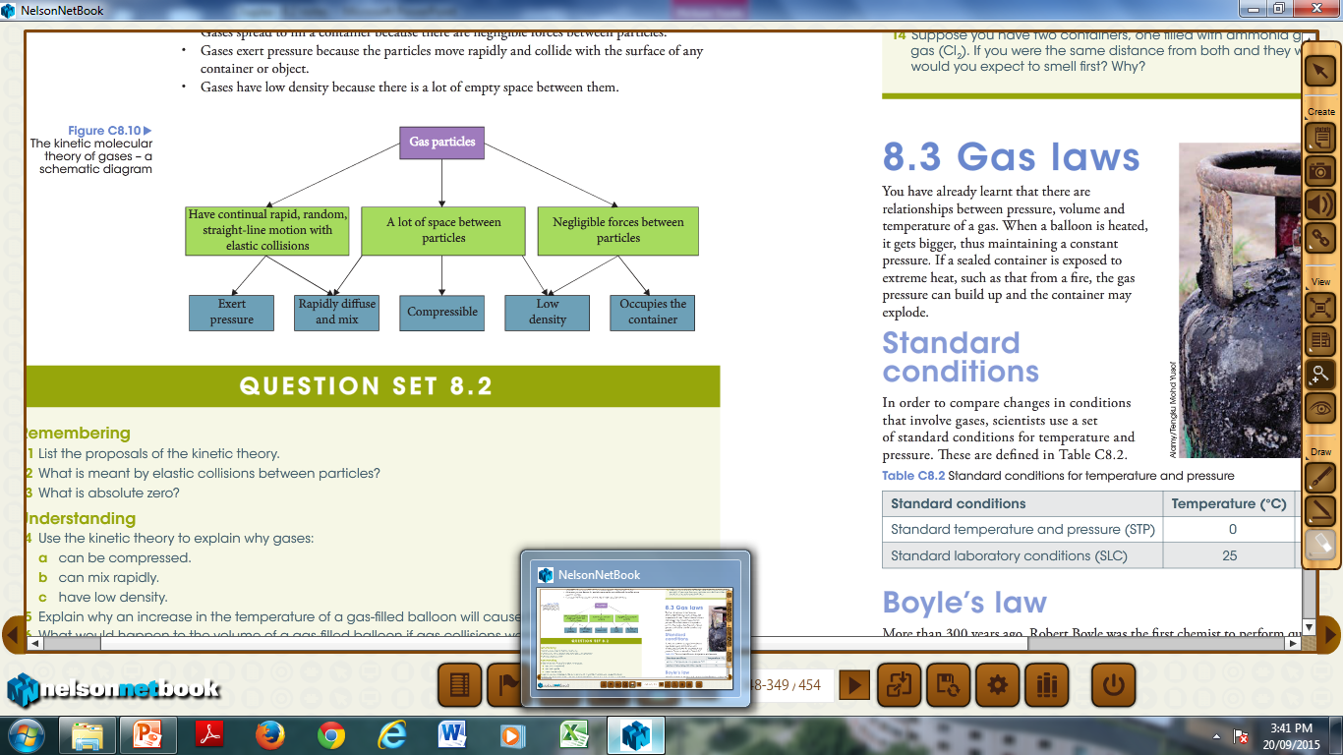

Slide 17
Do question set: 8.2 - 1,2, 3, 4, 8 ,9 (a and d), 11 and12

